Slide 1
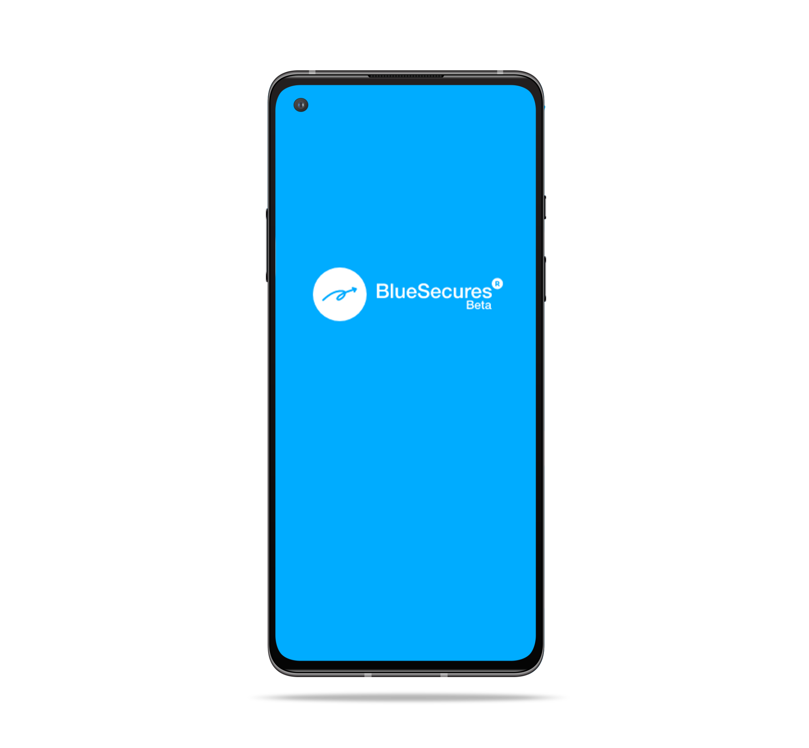
Customer On-boarding Guide
Version 1.0 February 2022
Deskfactors Inc. www.bluesecures.com

Slide 2
BlueSecures
Packed with Industry-Leading Technologies
Self-Service process for Customer Admin
Self-Service guide for Employees/Internal users
How to? Video Links
Bulk upload invite guide for Customer
CONTENT

Slide 3
Self Service Guide For Customer Admin:
Step:1
bit.ly/BlueSecures
Step:3
Download app
From Playstore
Register your business
Invite Employees, Customers, Suppliers, etc.
Start your secure business messaging
Step:2
Step:4

Slide 4
Self Service Guide For Company Employees/Internal Users:
Step:1
Step:3
Download app
From Playstore using invite message
Login with Ph.no
Invite Customers, Suppliers, etc.
Start your secure business messaging
Step:2
Step:4
Please find the VIDEO LINKS in Slide no.5

Slide 5
All Self Service Videos:
Videos:
BlueSecures : How it works?
https://drive.google.com/file/d/1QLsm2CzMvTB6znaFwC7ZC8wniDXQSuO5/view?usp=sharing
BlueSecures : Product features
https://drive.google.com/file/d/1k5dah3IT29vHBXqt9Tl034haR1hCawua/view?usp=sharing

Slide 6
Bulk Invite Upload for Customer Employees:
Step:1
bit.ly/BlueSecures
Step:3
Download app
From Playstore
Register your business
Download the excel template & fill the details
(find the template in next slide)
Send it to
blue@bluesecures.com
Step:2
Step:4
Please find the templates in Slide no.7

Slide 7
Bulk Upload Invite Templates:
Download the excel template, Read the instructions & fill the details and then send it to blue@bluesecures.com
Excel template: https://drive.google.com/drive/folders/1DZk4n_bZFBrBQ-qlIahg9x4WmMd0ICx1?usp=sharing
OR
Write to blue@bluesecures.com requesting bulk upload option, we’ll send you the template directly.

Slide 8
Thank you!

